Slide 1

Customer SEGMENTATION USING CLUSTERING
By Group 2
Shaik Mohammad Waseem Akram
Nishchay B N
Nikhita Bobbili
Kirti Kashinath Abachane
Yashwanthini Ayyakkannu

Slide 2

PROBLEM STATEMENT
In today’s competitive market, businesses need to understand their customers deeply to tailor marketing strategies, personalize services, and enhance customer satisfaction. However, when dealing with large and diverse customer bases, manually analyzing individual behavior becomes impractical.
The goal of this project is to perform Customer Segmentation using unsupervised learning techniques. By analyzing customer purchasing behavior and demographic features, we aim to group similar customers together. This segmentation will help the business:
Improve targeted marketing campaigns
Identify high-value customer segments
Enhance customer retention and engagement strategies

Slide 3

DATASET DETAILS
COLUMN NAME | DESCRIPTION
ID | Unique identifier for each customer.
YEAR_BIRTH | Year of birth of the customer
EDUCATION | Education level (e.g., Graduation, PhD, Master, etc.)
MARITAL_STATUS | Marital status (e.g., Married, Single, Together)
KIDHOME | Number of children in the household
TEENHOME | Number of teenagers in the household
DT_CUSTOMER | Date when the customer was enrolled
RECENCY | Number of days since last purchase
MNTWINES | Amount spent on wine in the last 2 years
The dataset for this project should contain the demographic, purchase behavior, and marketing response information for each customer. Below is an overview of the key features:

Slide 4
COLUMN NAME | DESCRIPTION
MNTFRUITS | Amount spent on fruits in the last 2 years
MNTMEATPRODUCTS | Amount spent on meat products in the last 2 years
MNTFISHPRODUCTS | Amount spent on fish products in the last 2 years
MNTSWEETPRODUCTS | Amount spent on sweet products in the last 2 years
MNTGOLDPRODS | Amount spent on gold products in the last 2 years
NUMDEALSPURCHASES | Number of purchases made using a discount
NUMWEBPURCHASES | Number of purchases made through the website
NUMCATALOGPURCHASES | Number of purchases made using a catalog
NUMSTOREPURCHASES | Number of purchases made in stores
NUMWEBVISITMONTH | Number of visits to the website in the last month
ACCEPTEDCMPL-5 | Whether the customer accepted marketing campaigns 1 to 5
COMPLAIN | Whether the customer complained
Z_COSTCONTACT | Cost of last marketing campaign sent
Z_REVENUE | Revenue from the last marketing campaign
RESPONSE | Whether the customer accepted the last campaign

Slide 5

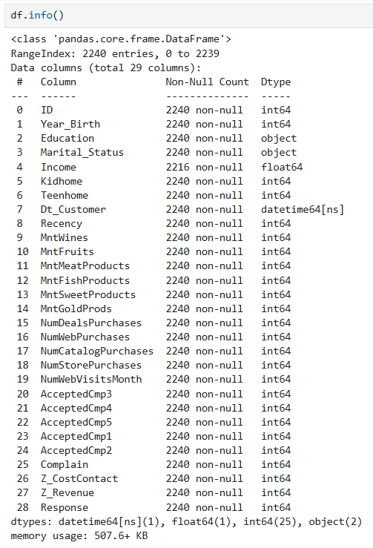
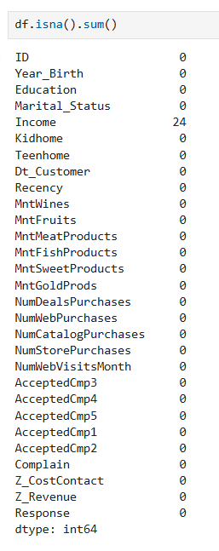
EXPLORATORY DATA ANALYSIS
DATA CLEANING:
checking for the null values
examining the data types
changing the data types of required columns
resulting null values are dropped using dropna().
dropping unnecessary columns like Complain , Z_CostContact …

Slide 6
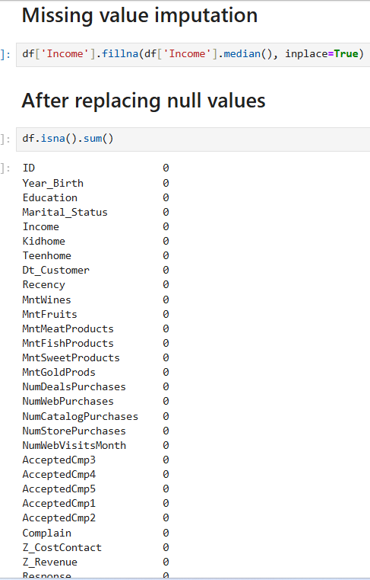
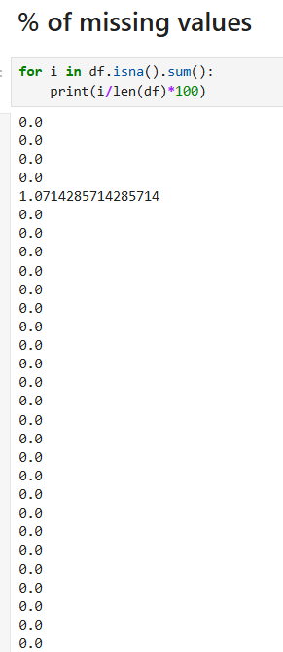

Slide 7
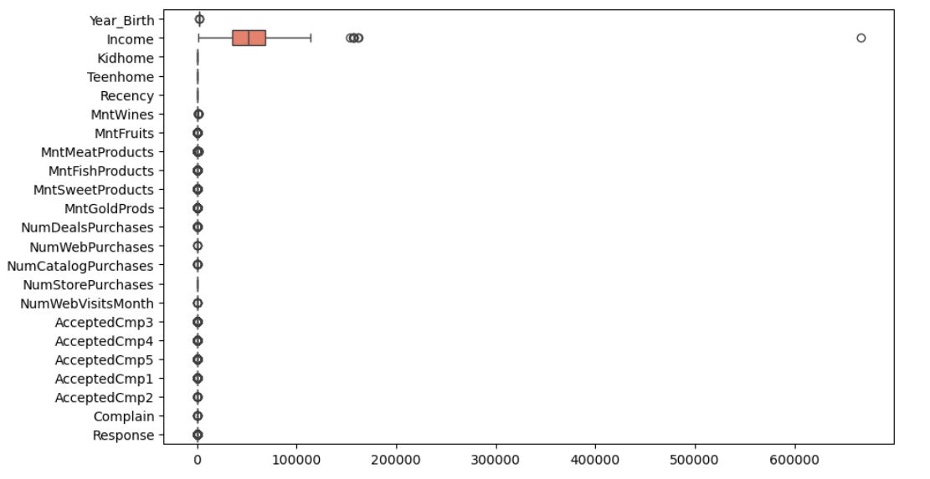
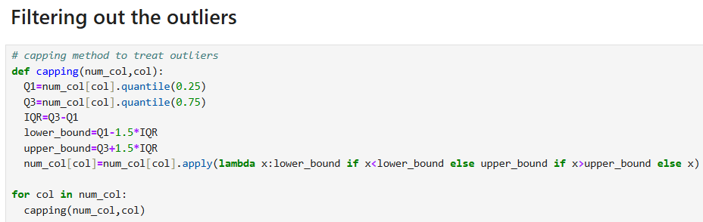
OUTLIER DETECTION

Slide 8

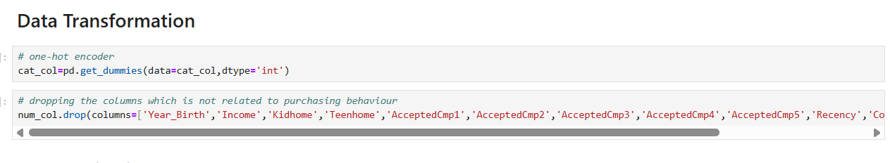
TRANSFORMATION

Slide 9
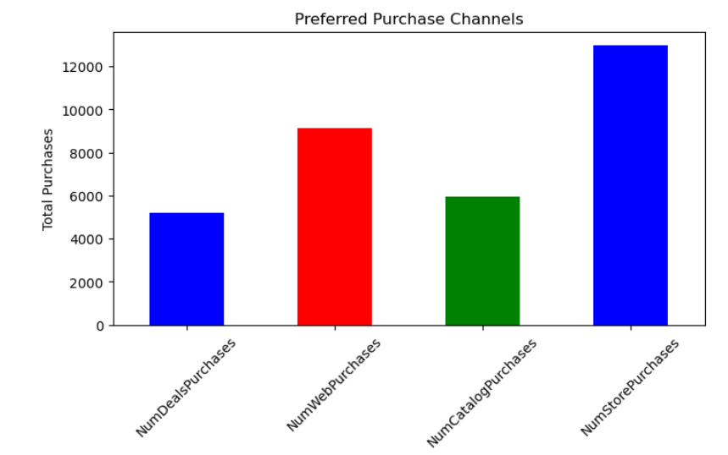
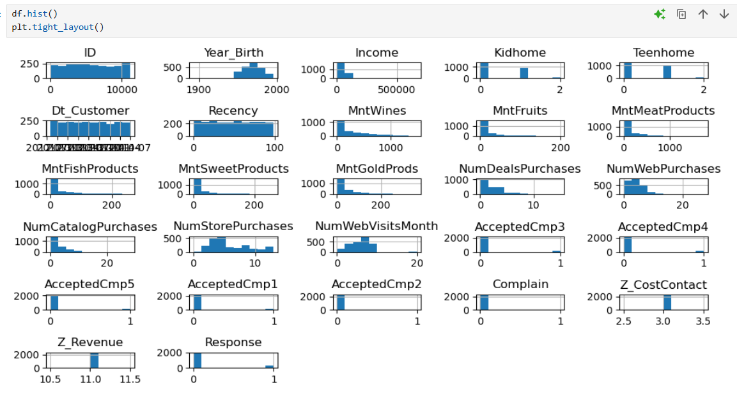
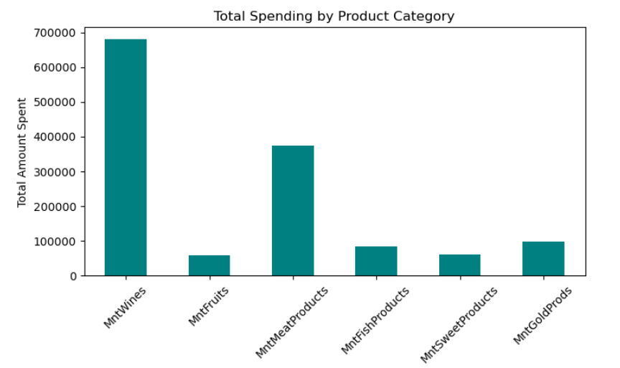
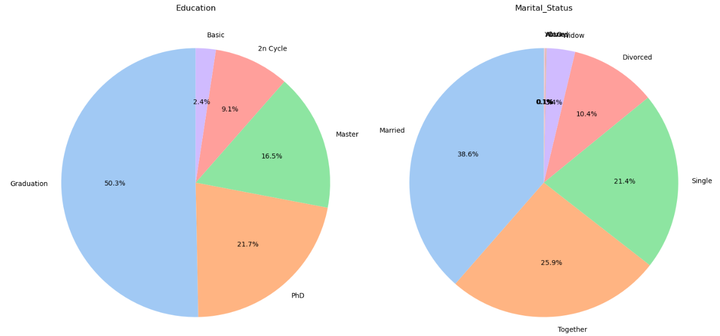
DATA VISUALIZATION
DATA VISUALIZATION- used boxplot, countplot, barplot, KDE plot, pie chart, scatter plot to further deepen our understanding of the dataset.

Slide 10
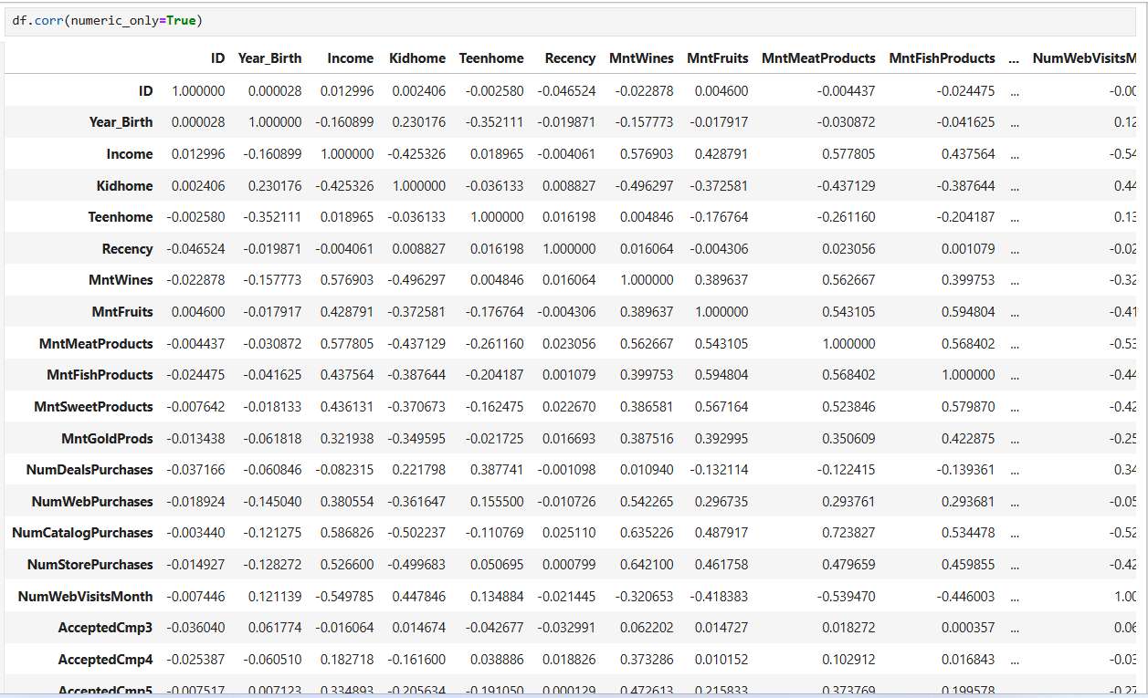
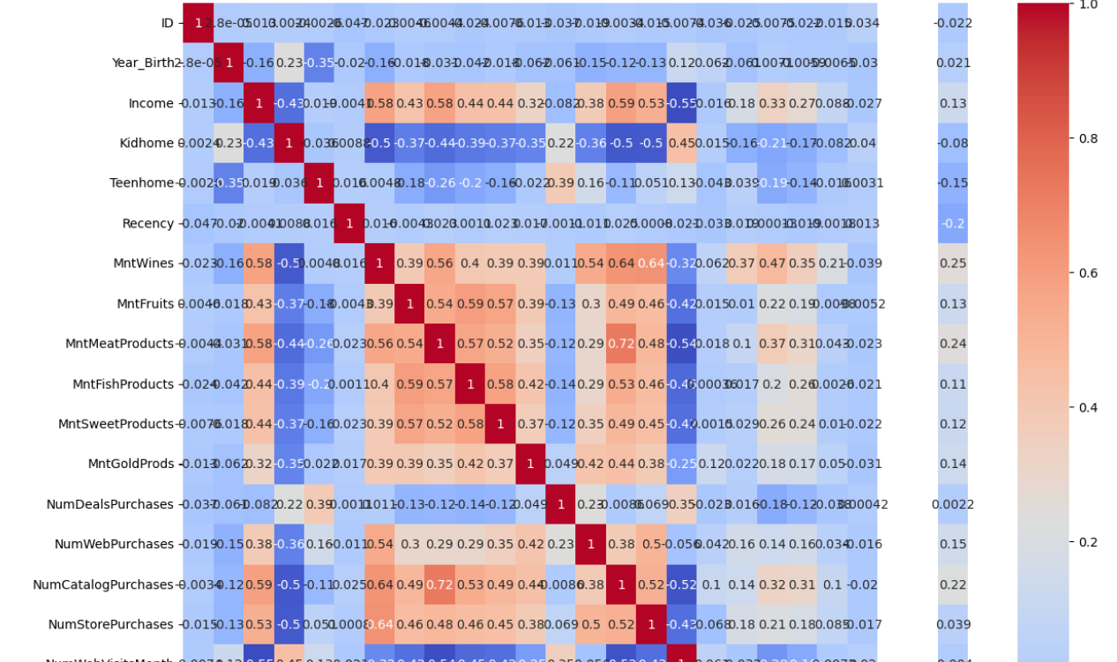
The correlation values and predictive power scores of the dataset are thoroughly examined.

Slide 11
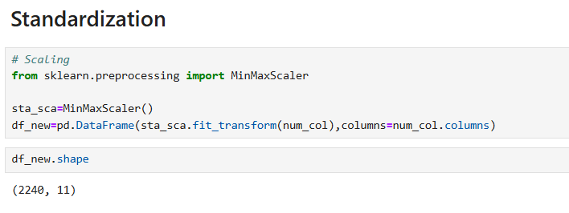
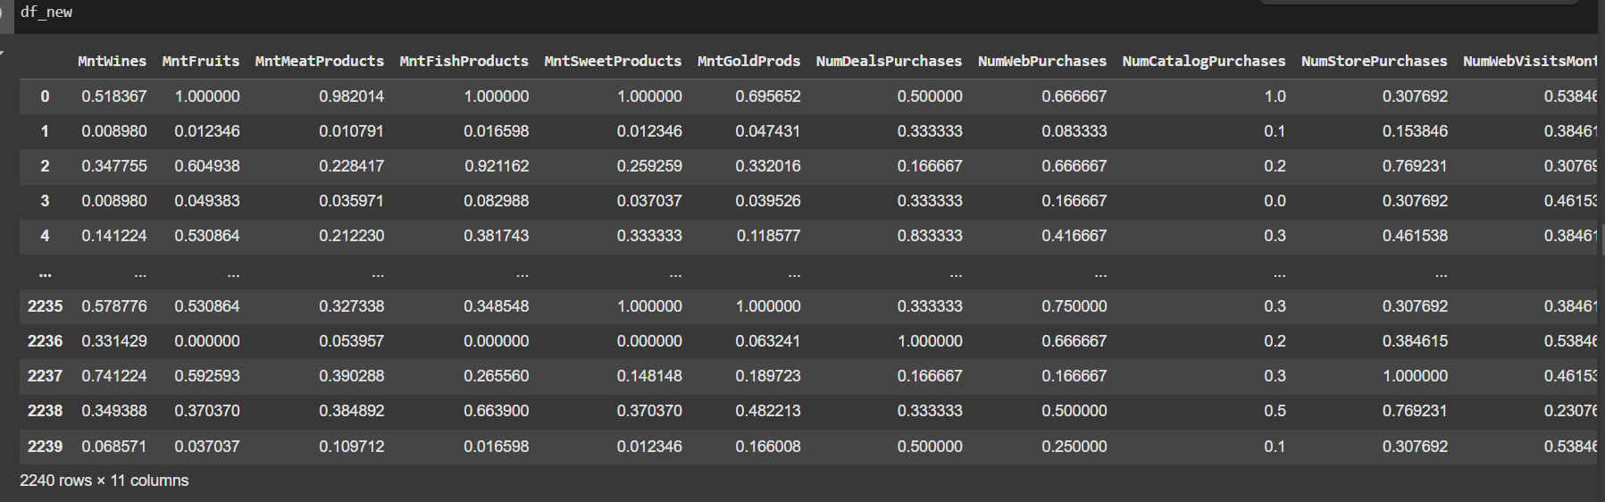
FEATURE ENGINEERING

Slide 12
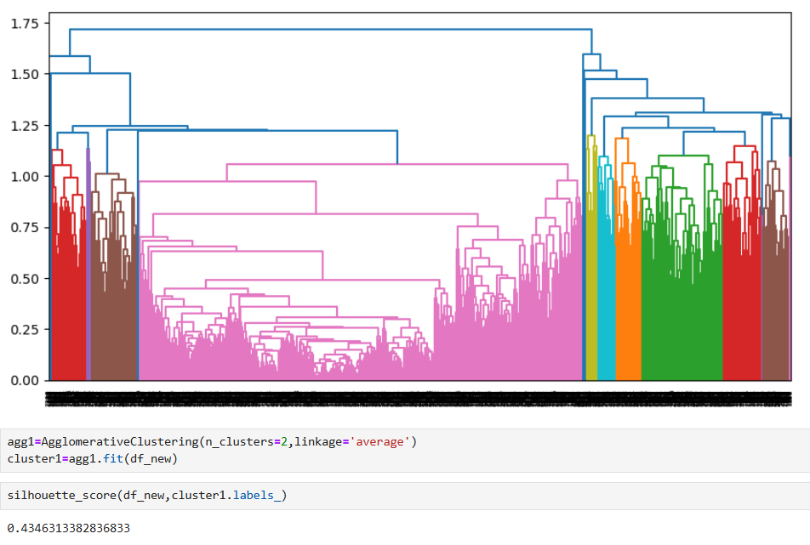
MODEL BUILDING
We used unsupervised machine learning techniques to segment customers based on their purchasing behavior. The main model used was:
Agglomerative
K-Means
DBSCAN
Average Linkage

Slide 13
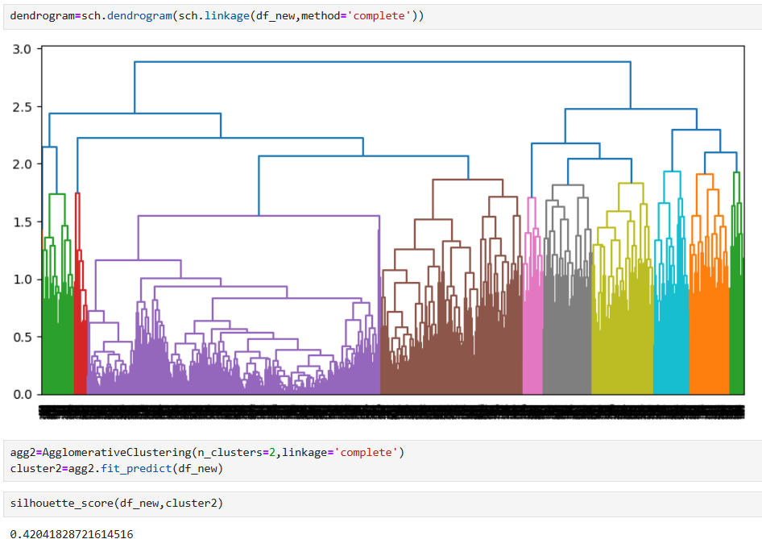
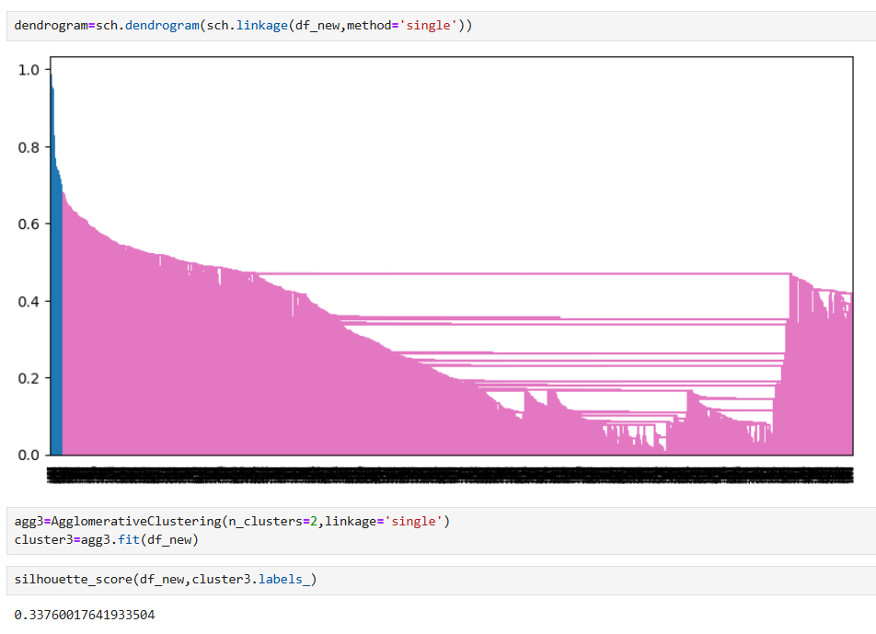
Complete Linkage
Single Linkage

Slide 14
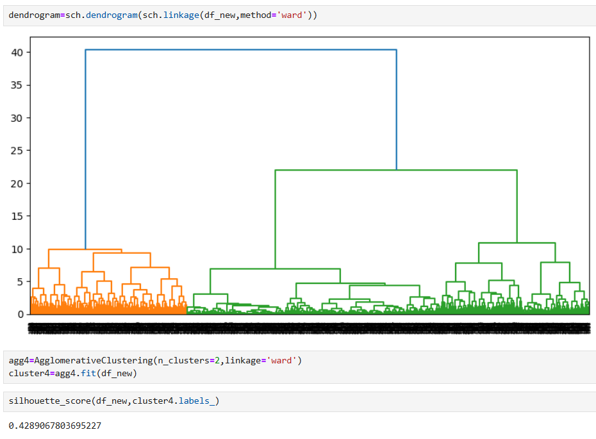
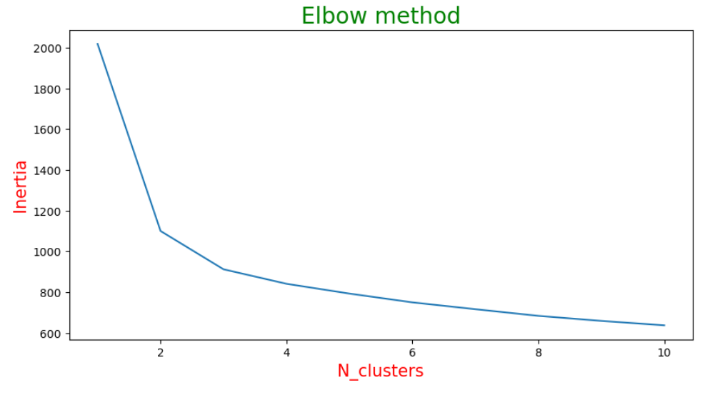
Ward
Elbow Method

Slide 15
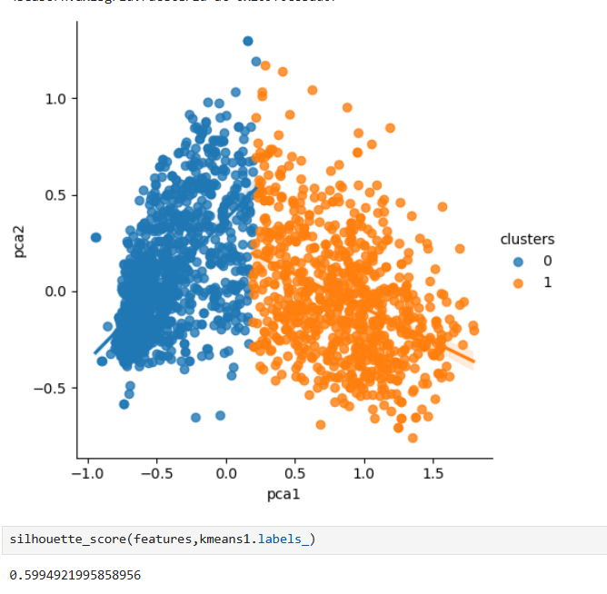
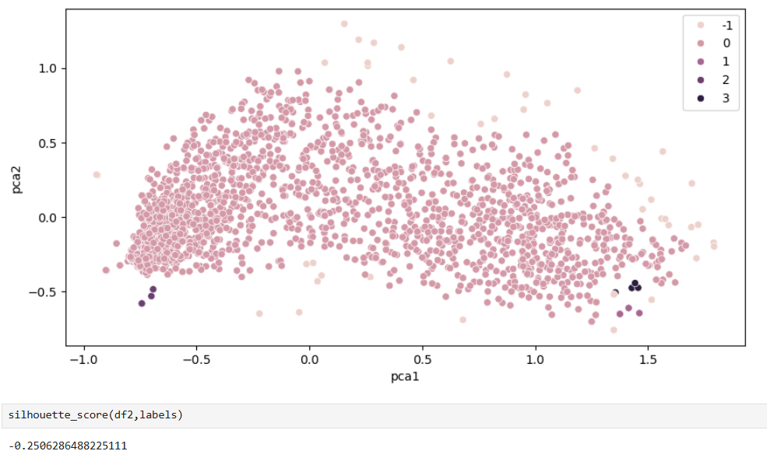
Kmeans With PCA
DBSCAN

Slide 16
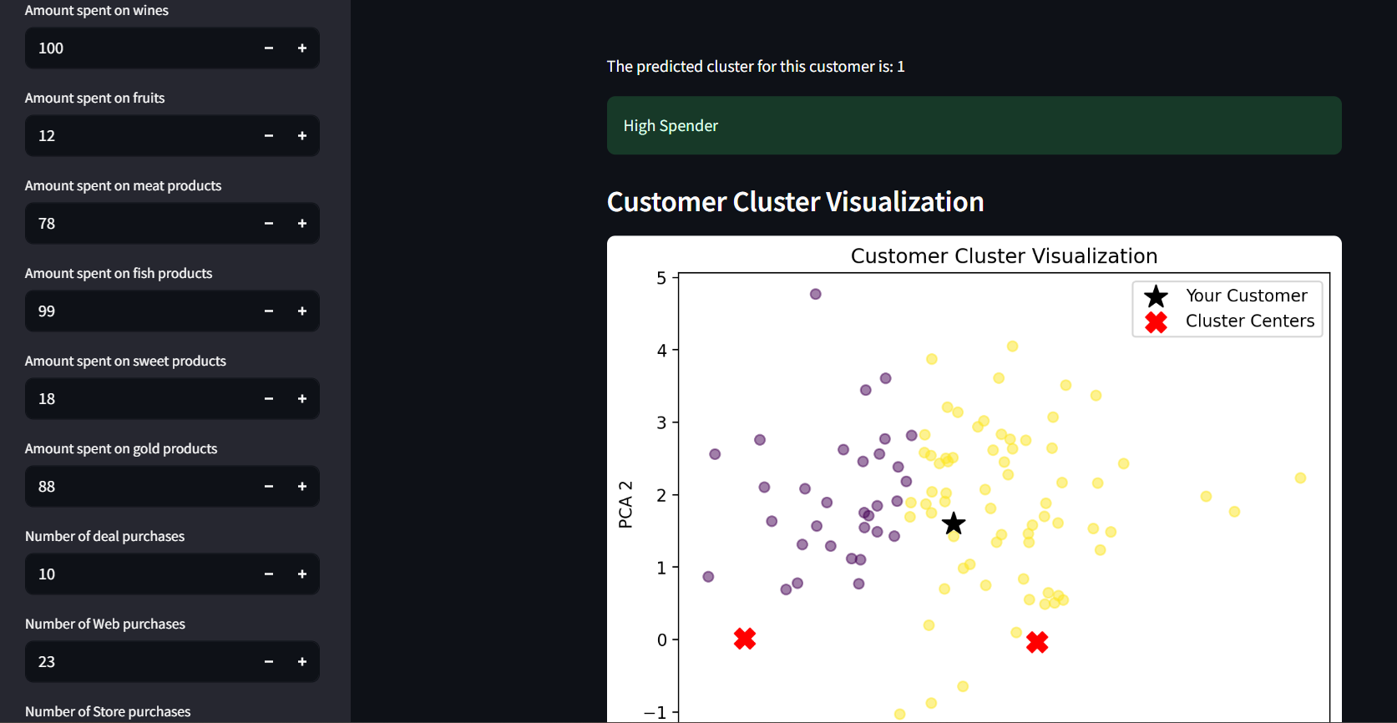
DEPLOYMENT
We used Streamlit, a Python-based web framework, to build an interactive web application for customer segmentation. The clustering model is deployed as a real-time web app, allowing users to input customer purchase and behavior details and instantly receive the predicted customer segment (High Spender or Low Spender). The app also includes dynamic visualizations like scatter plots and bar charts to provide intuitive insights into customer behavior and segment distribution.

Slide 17
Thank you

